Slide 1
DLIR Incident Response
Notes:
Good afternoon, my name is Ryan Talabis, I’m a consultant for Secure-DNAs We’re a security and consulting firm based in Hawaii. I’m also a member of the Hawaii Honeynet Project. A lot of my research probably stems from the fact that I live in an island that has a very high concentration of military facilities and bases. Plus I’m Filipino and I did some data mining research for one of the Philippine agencies regarding this terrorist group called the Abu Sayyaf. So what has this got to do with my research? For that, let me give you a brief background.

Slide 2
Agenda
Initial Response Activities
Root Cause Analysis
Impact Analysis
Conclusions
Recommendations

Slide 3
Initial Response
The following initial activities were conducted:
  Ran SDNA incident response scripts
  Performed full port scan of system
  Performed vulnerability scan of system
  Performed traffic analysis
  Disconnection of the system

Slide 4
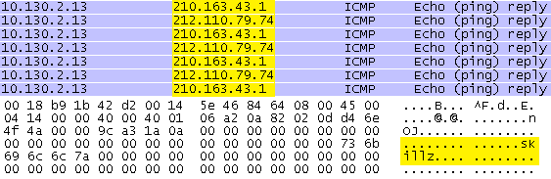
Analysis
Noted suspicious traffic verifying DDOS alerts

Slide 5
Root Cause
The following activities were conducted for root cause analysis:
  Review of SSH connection logs
  Review of system “lastlog”
  Review of other system logs extracted from initial response

Slide 6
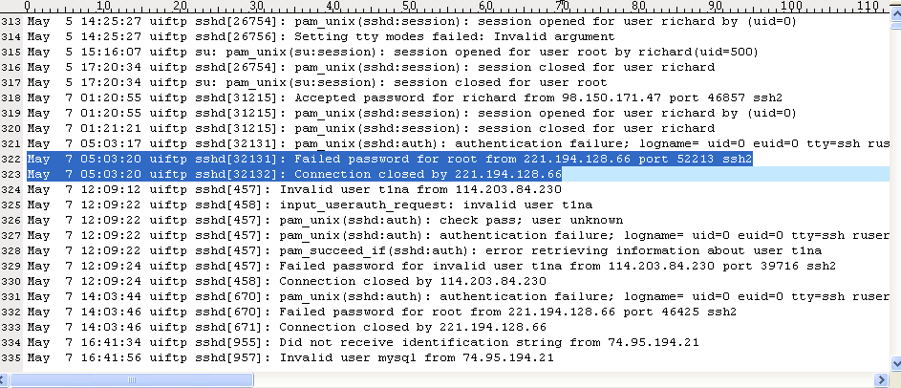
Analysis
Noted brute force attacks started May 7, 2009

Slide 7
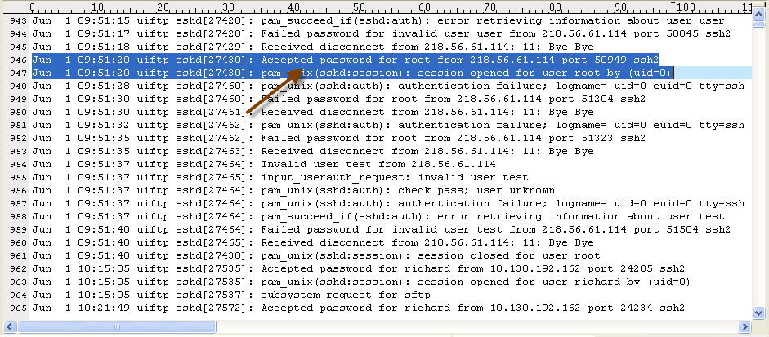
Analysis
First successful attack (source China) occurred on June 1, 2009

Slide 8
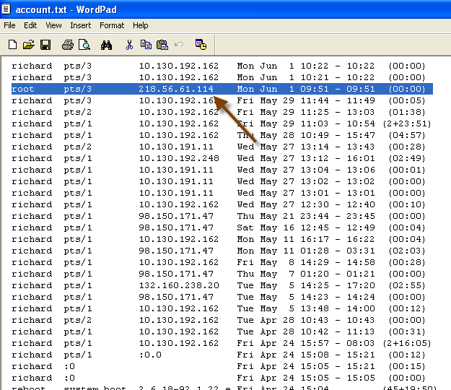
Analysis
Noted successful “root” session created in the system

Slide 9
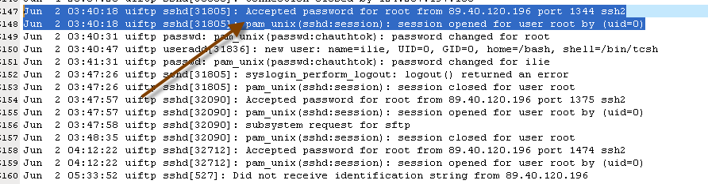
Analysis
Second successful attack against “root” on June 2, 2009 from different source (Romania)

Slide 10
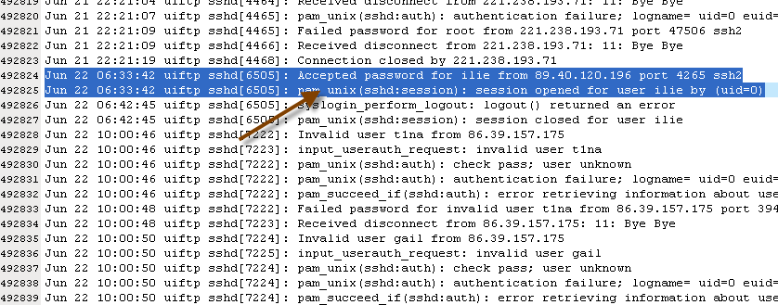
Analysis
Another successful attack against account “ilie” on June 22, 2009 from Romanian source

Slide 11
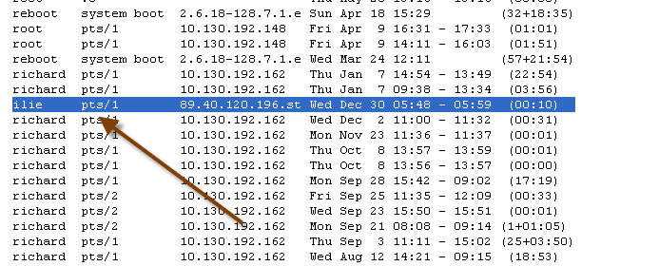
Analysis
Most recent compromised session (“ilie”) on December 30, 2009

Slide 12
Impact Analysis
The following activities were conducted for impact analysis:
  Review of listening services
  Review of running processes
  Review of compromised files
  Review of network configuration

Slide 13
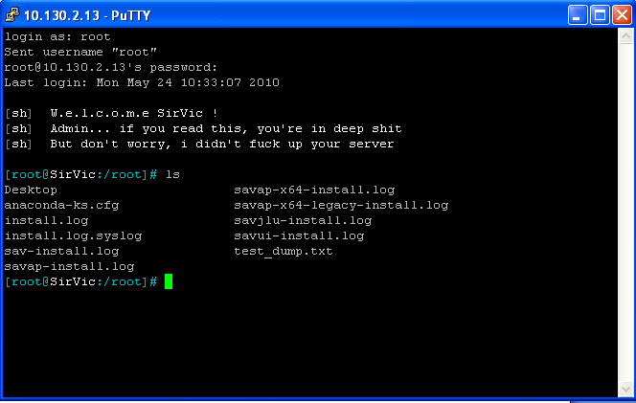
Analysis
System was installed with backdoor providing root access

Slide 14
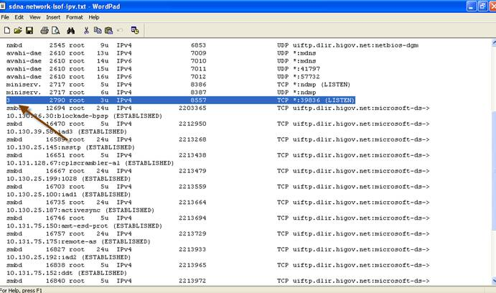
Analysis
Backdoor is running on port 39836. Note that regular SSH interface on port 22 was compromised also.

Slide 15
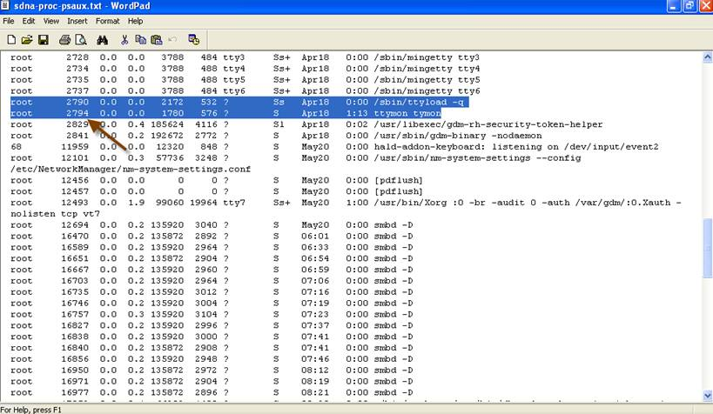
Analysis
Discovered infected files/binaries running in the system.

Slide 16
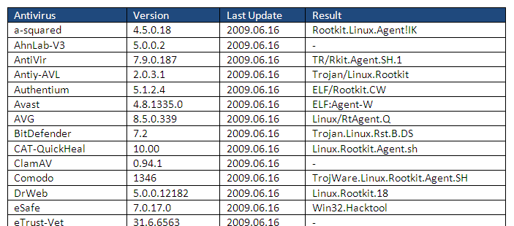
Analysis
Analysis using multiple anti-virus shows that files/binaries appear to be a rootkit

Slide 17
Analysis
A rootkit is a type of software that is designed to gain administrator-level control over a computer system without being detected.
In virtually all cases, the purpose and motive is to perform malicious operations on a target host computing system at a later date without the knowledge of the administrators or users of that system.

Slide 18
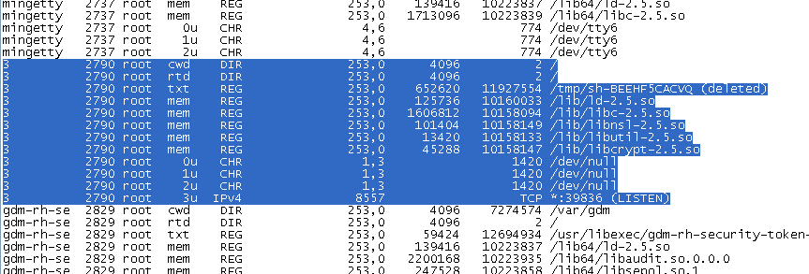
Analysis
Multiple other files running under “suspicious” processes

Slide 19
Conclusions
System has been compromised for at least 9 to 10 months
Different attackers may have had access to the system
System infected with rootkit which makes all transactions performed in the system suspect
Main SSH interface accessible to the internet was compromised
System also has backdoor but may have been blocked by firewall rules

Slide 20
Recommendations
Remove infected host from network and sanitize
Use true DMZ architecture
Restrict inbound architecture
Enable logging and offline storage of firewall logs
Harden external facing hosts
Scanning of external facing servers
Scanning of internal servers

Slide 21
Questions
Questions and Discussion

